Slide 1
2.4 Local optimization methods

Slide 2
Local optimization methods work by taking a single sample input and refine it sequentially, driving it towards an approximate minimum point.
Local optimization methods are by far the most popular mathematical optimization schemes used in machine learning today.
Indeed local optimization algorithms being the subject of the remaining of this as well as the next two Chapters.
While there is substantial variation in the kinds of specific local optimization methods we will discuss going forward, they all share a common overarching framework which we introduce in this Section.

Slide 3
The big picture

Slide 4
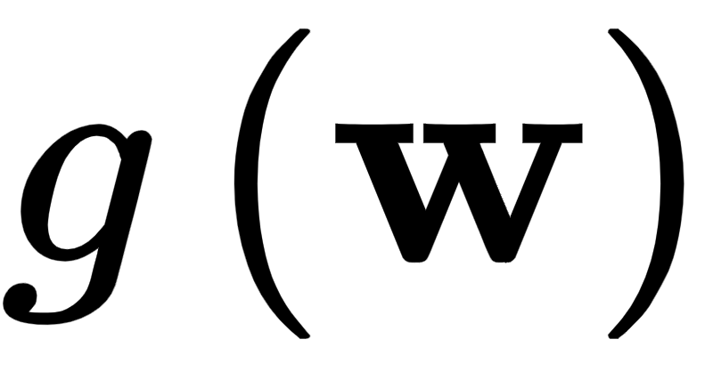
As we saw in the previous Section global optimization methods test a multitude of simultaneously sampled input points to determine an approximate minimum of a given function .
Local optimization methods, on the other hand, work in the opposite manner sequentially refining a single sample input called an initial point until it reaches an approximate minimum.

Slide 5
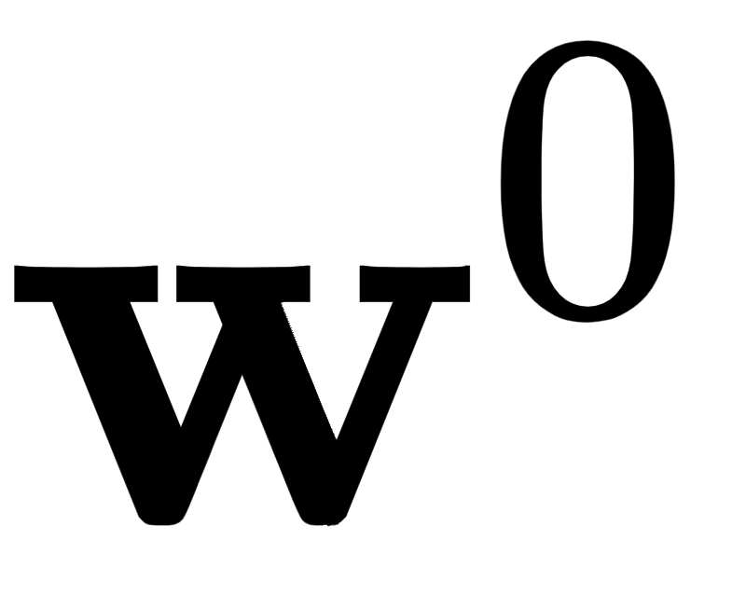

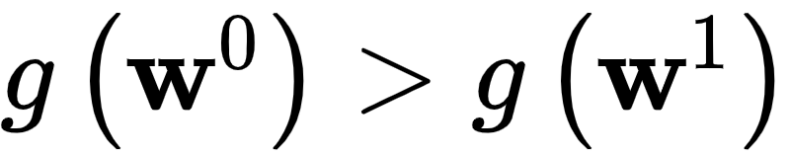
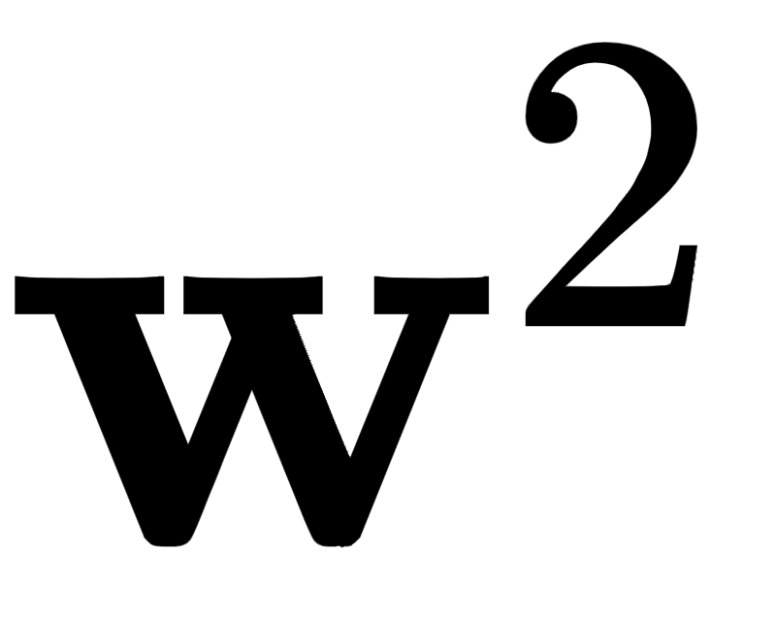
Starting with a sample input / initial point , local optimization methods refine this initialization sequentially pulling the point 'downhill' towards points that are lower and lower on the function.
From the point is 'pulled' downhill to a new point lower on the function i.e., where . The point then itself 'pulled' downwards to a new point , etc.

Slide 6
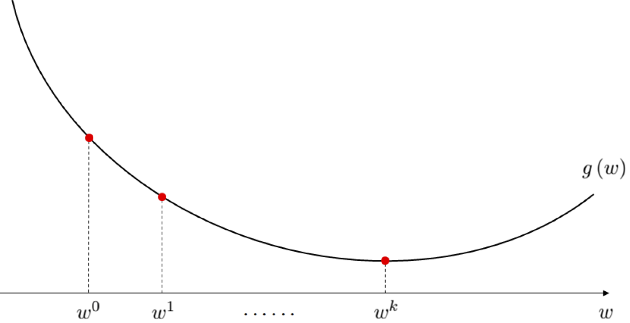

Slide 7
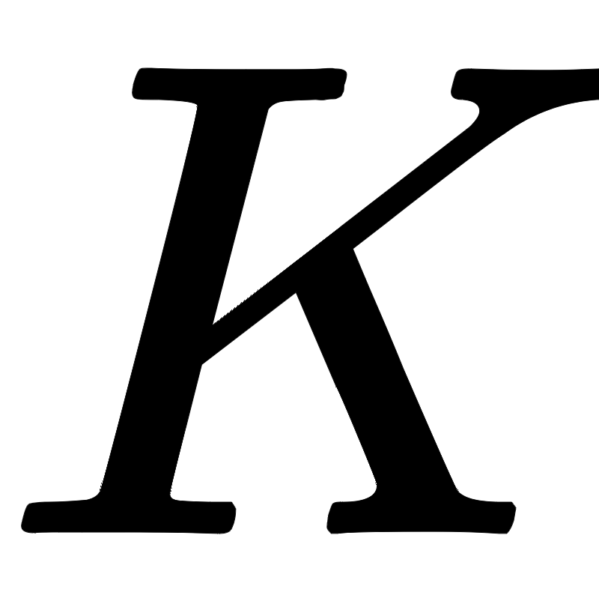
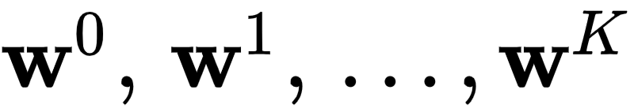
This refining process yields a sequence of points (starting with our initializer)
Here each subsequent point is (again generally speaking) on a lower and lower portion of the function i.e.,

Slide 8
Unlike the global approach, a wide array of specific local optimization methods scale gracefully with input dimension.
This is because the sequential refinement process - which can be designed in a variety of ways - can be made extremely effective.

Slide 9
The general framework

Slide 10
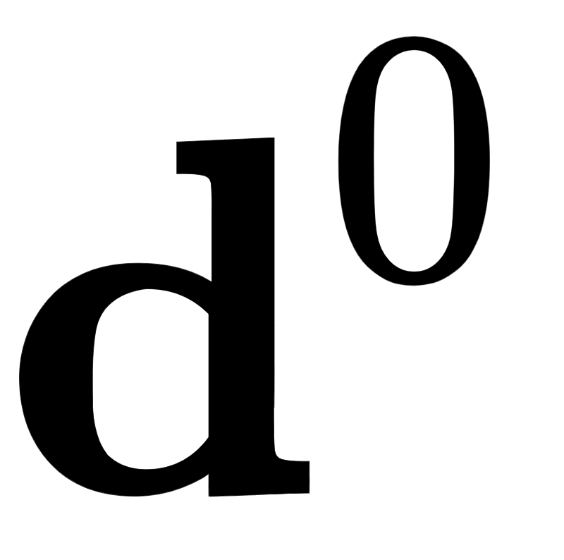
Every local method, regardless of form, works generally as follows.
To take the first step from an initial point to the very first update (which should be lower on the function than the initializer) what is called a descent direction is at is found.
This is a direction vector in the input space that stems from - i.e., it begins at and points away from the initial point - that if followed leads to an input point with lower function evaluation.

Slide 11
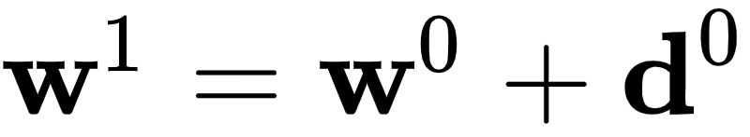
When such a direction is found the first update $\mathbf{w}^1$ is then literally the sum

Slide 12


Slide 13
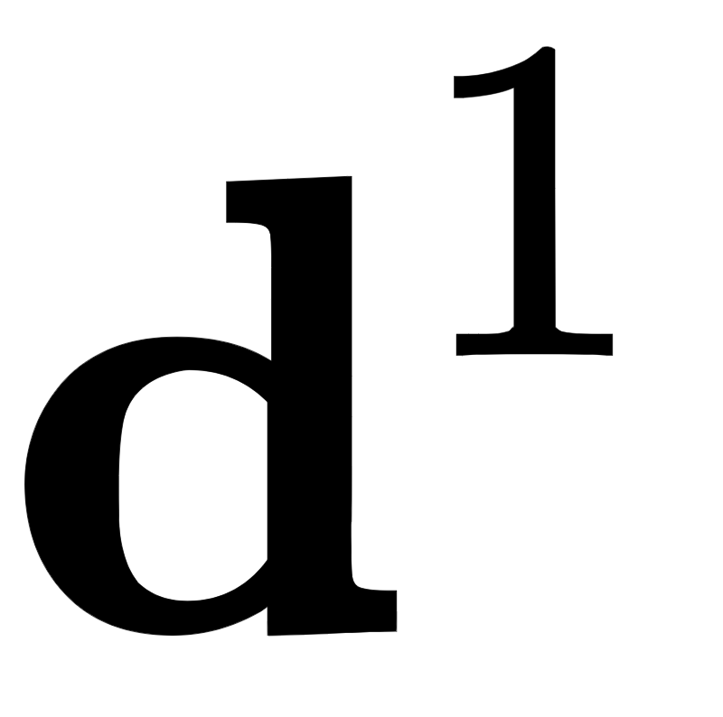
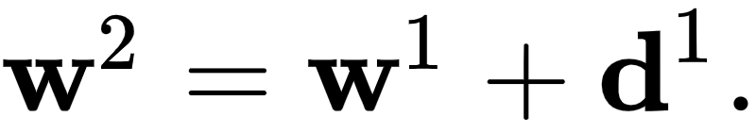
To refine the point we look for a new descent direction - one that moves 'downhill' stemming from the point .
When we find such a direction the second update is then formed as the sum
And we keep going like this, determining further descent directions producing - in the end - a sequence of input points (starting with our initializer) that goes as follows.

Slide 14
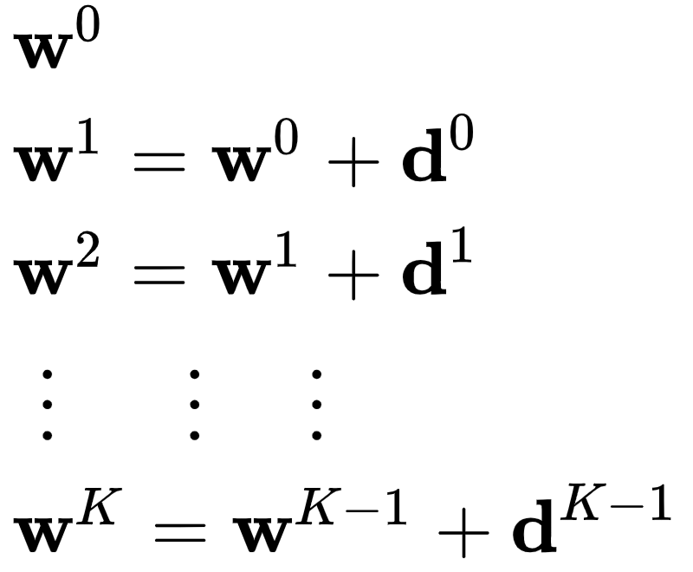
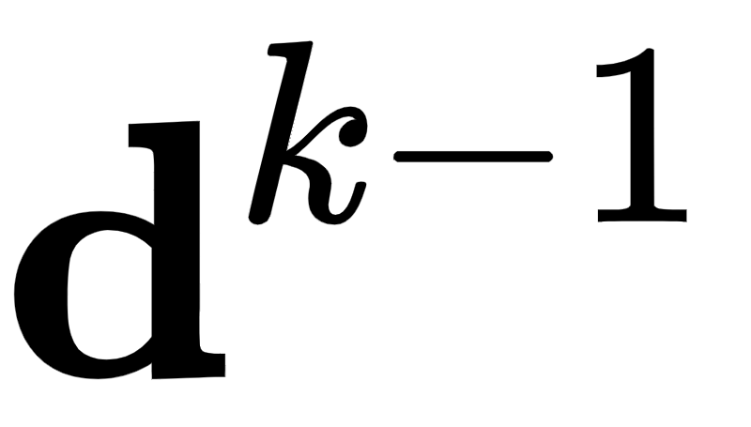
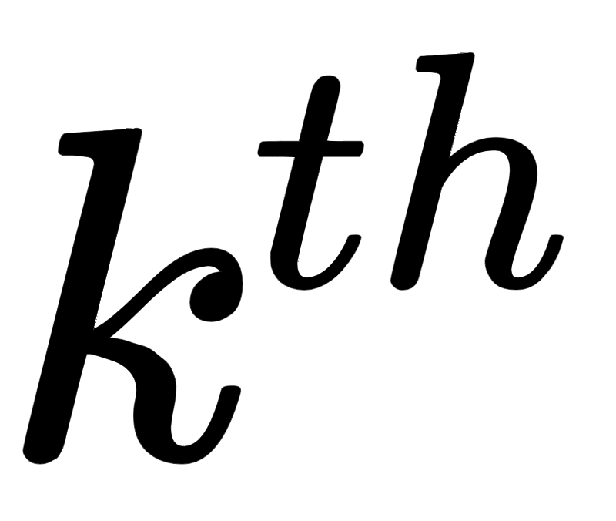
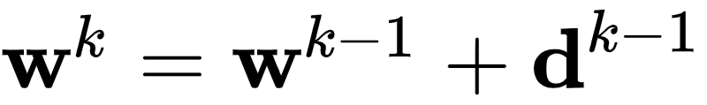
Here is the descent direction defined at the step of the process:
And we have

Slide 15
How are these descent directions stemming - stemming from each subsequent update - actually found?

Slide 16
There are a multitude of ways of determining proper descent directions - indeed in the remaining Sections of this Chapter we discuss zero-order (also called Hessian free) approaches for doing this.
In the following Chapters we describe first and second order approaches (i.e., approaches that leverage the first and/or second derivative of a function to determine descent directions).
In other words - it is precisely this - how the descent directions are determined - which distinguishes local optimization schemes from one another.

Slide 17
The steplength parameter

Slide 18
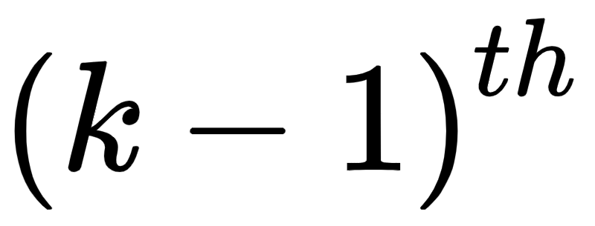
- We can easily calculate precisely how far we travel at the step of a generic local optimization scheme.
Measuring the distance traveled from the previous point we can see that we move a distance precisely equal to the length of the descent direction as

Slide 19
Depending on how our descent directions are generated we may or may not have control over their length (all we ask is that they point in the right direction, 'down hill').
This can mean even if they point in the right direction - towards input points that are lower on the function - that their length could be problematic.

Slide 20
If for example, they are too long then a local method can oscillate wildly at each update step never reaching an approximate minimum, or likewise if they are too short in length a local method we move so sluggishly slow that far too many steps would be required to reach an approximate minimum.
Both of these potentialities are illustrated in the Figure below.

Slide 21
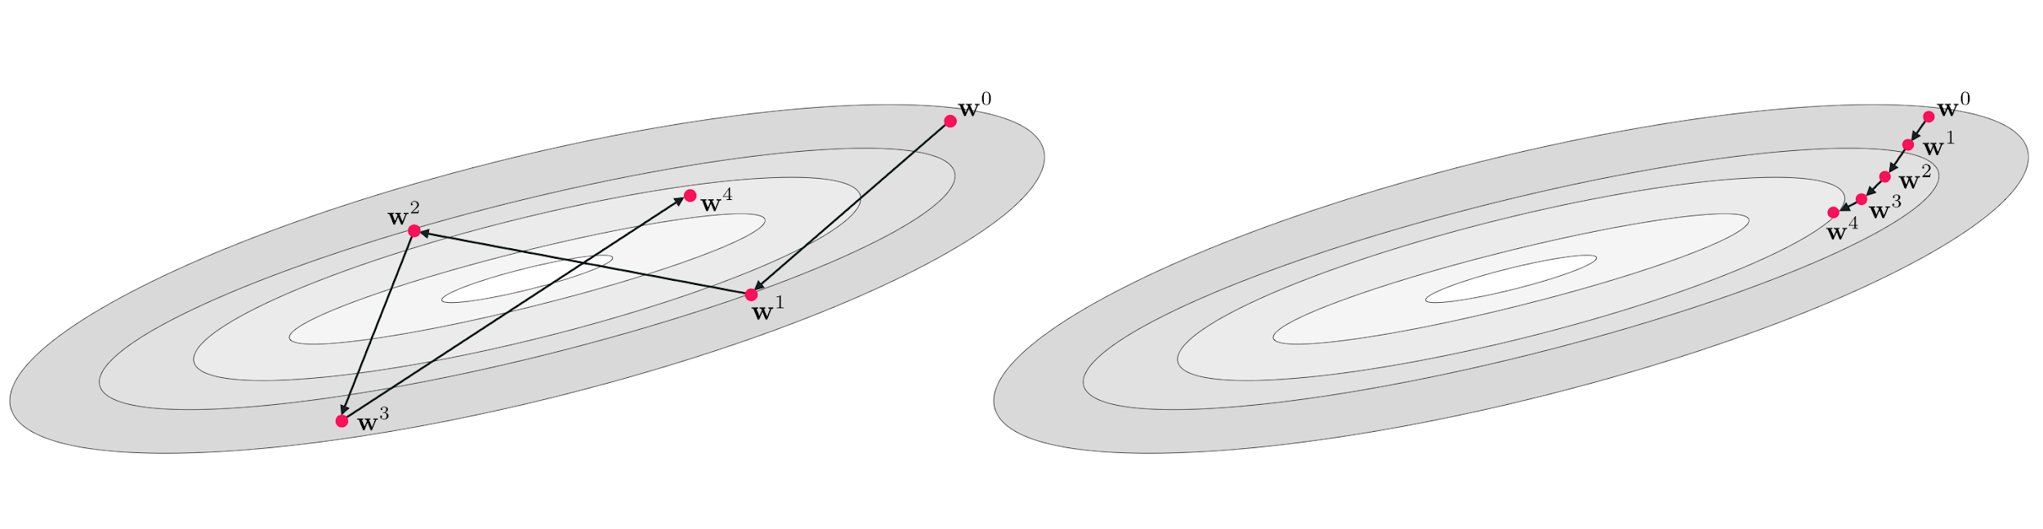

Slide 22

Because of this potential problem many local optimization schemes come equipped with what is called a steplength parameter (also called a learning rate parameter).
We control this value, and it helps us more directly control the length of each update step (hence the name steplength parameter).
This is simply a parameter - typically denoted by the Greek letter - that is added to the generic local optimization update scheme described above

Slide 23
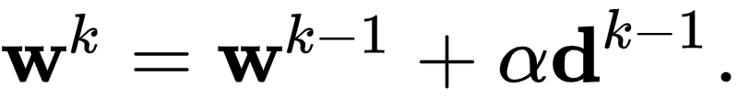
With a step-length parameter the generic update step in equation (6) is written analogously as

Slide 24
The only difference between this form for the step and the original is that now we scale the descent direction by the parameter - which we can set as we please.
Re-calculating the distance traveled by the step with this added parameter we can see that

Slide 25
In other words the length of the step is now proportional to the descent direction, and we can fine tune precisely how far we wish to travel in its direction by setting as we please.
A common choice is to set to some fixed small constant value for each of the K steps - but like local optimization methods themselves there are a number of ways of usefully setting the step-length parameter which we will discuss in the future.

